Slide 1

Name: Salem Khalaf Alsirheed ID:201505095

Slide 2
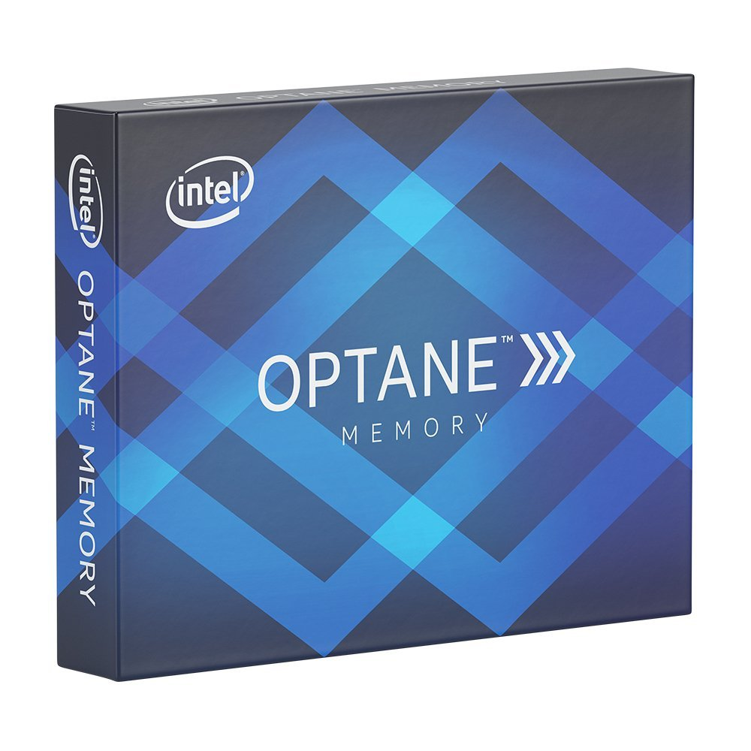
Intel® Optane™ memory

Slide 3
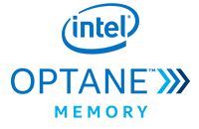
Outline
What is Intel® Optane™ memory ?
What is the benefit of this technology?
Intel® Optane™ memory modules and price .
Advantages and Disadvantages of this technology .

Slide 4
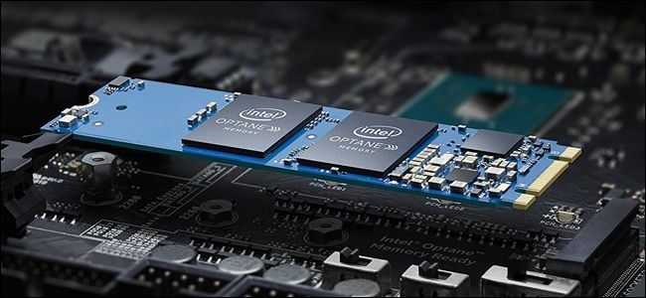
What is Intel® Optane™ memory ?
Optane technology: Is a new technology made by Intel which a memory archive files commonly used to facilitate access to them when requested again .

Slide 5
What is the benefit of this technology?
Helps to execute tasks faster
Reduce the time period of operations
Such as:
Start or boot
Search and find files
Save and move large files
Launch applications
Game level loading
Improve HDD speed

Slide 6
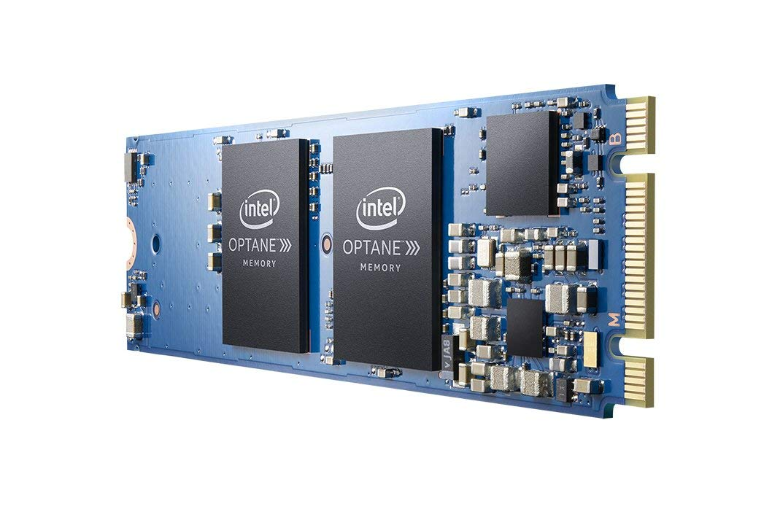
Intel® Optane™ memory modules and price
It has only two Modules :
Modules
32GB | 16GB
Price
60$ | 34$

Slide 7
The advantages and disadvantages
of this technique
Advantages :
Fast
Non-volatile memory
Dense
Disadvantages :
It supports limited motherboard and processors
It’s only 7th Gen Intel® Core™ or later
Also the application is only available in the Microsoft Store and
System must have Windows® 10 or later.

Slide 8
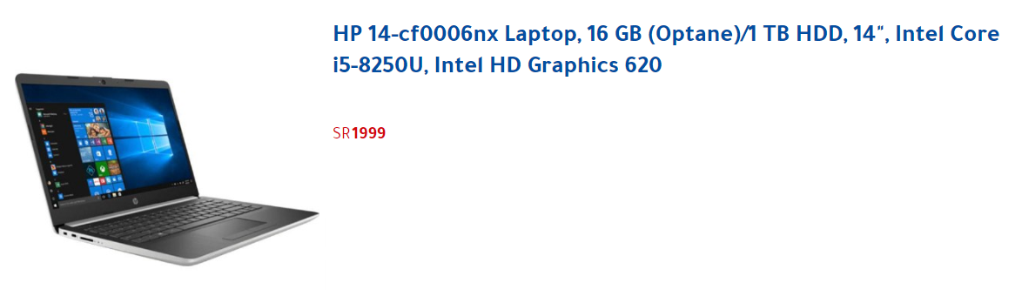
Example:
Before You Buy, Key Requirements:
https://www.intel.me/content/www/xr/ar/support/articles/000023994/memory-and-storage/intel-optane-memory.html

